Slide 1
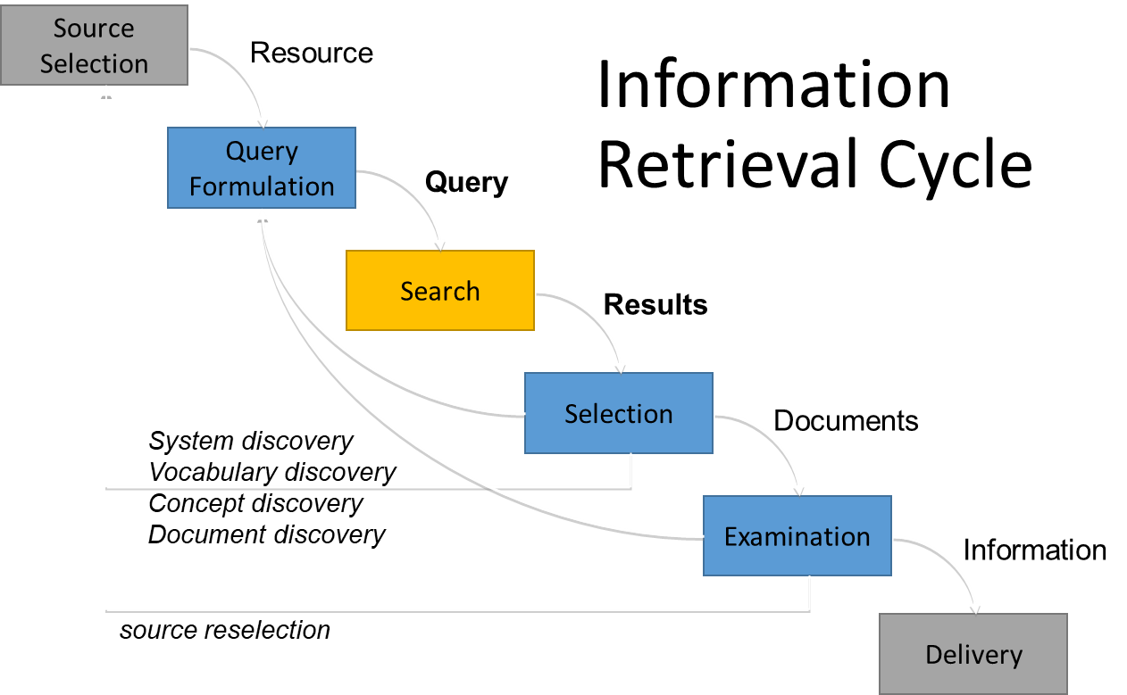
Information retrieval
IR is concerned with representing, searching and manipulating large collection of electronic text and other human language data

Slide 2
Boolean Retrieval model
Information Retrieval Models
It is exact retrieval model.
Is precise: document matches condition or not -> exact match
Two possible outcomes of query evaluation: True or False
Views each document as a set of words
Use cases - Email, library catalog
A weight w_{ij} > 0 is associated with each term t_{i}
Query terms are combined logically using the Boolean operators AND, OR, and NOT.
The retrieval results are usually quite poor because term frequency is not considered.
Strengths
Precise, if you know the right strategies and have an idea of what you’re looking for
Fast and efficient
Weaknesses
Users must learn Boolean logic
No control over size of result set: either too many hits or none
Documents that “don’t quite match” the query may be useful also
2

Slide 3
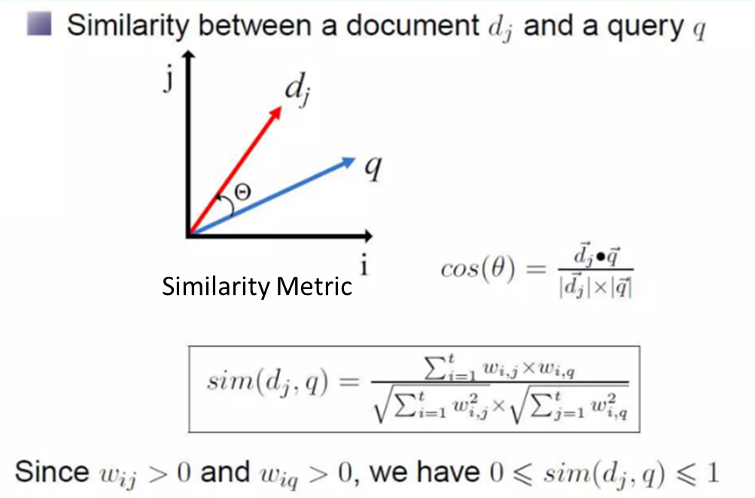
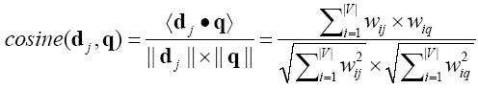
Vector Space Model
Information Retrieval Models
Documents that are “close together” in vector space will be retrieved. Therefore, retrieve documents based on how close the document is to the query (i.e., similarity ~ “closeness”)
Relevance of d_{i} to q: Compare the similarity of query q and document d_{i}.
Cosine similarity (the cosine of the angle between the two vectors)
Cosine is also commonly used in text clustering

Slide 4
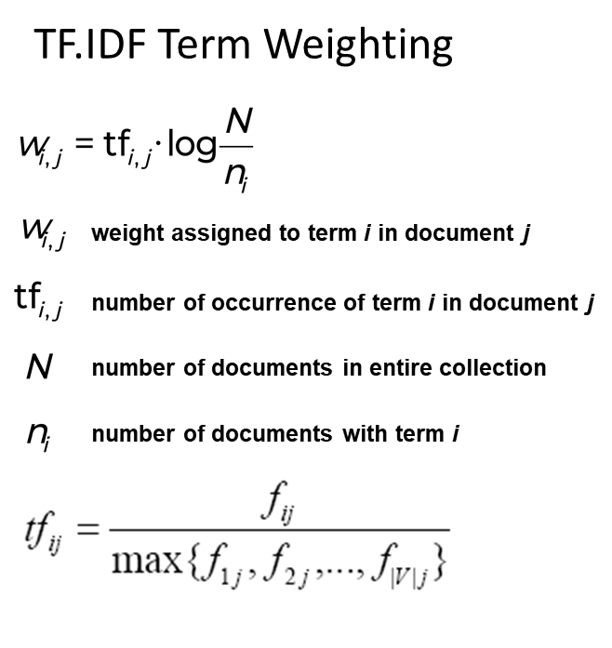
Documents are treated as a “bag” of words or terms.
Each document is represented as a vector.
However, the term weights are no longer 0 or 1. Each term weight is computed based on some variations of TF-IDF
Term Frequency - Inverse Document Frequency (TF-IDF) measures how important a term is within a document relative to a collection of documents

Slide 5
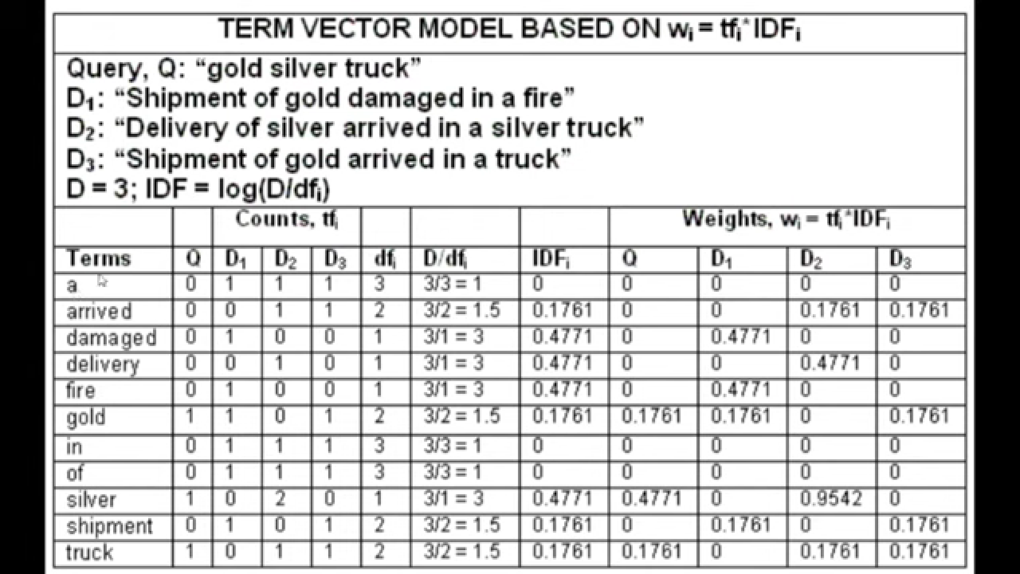

Slide 6
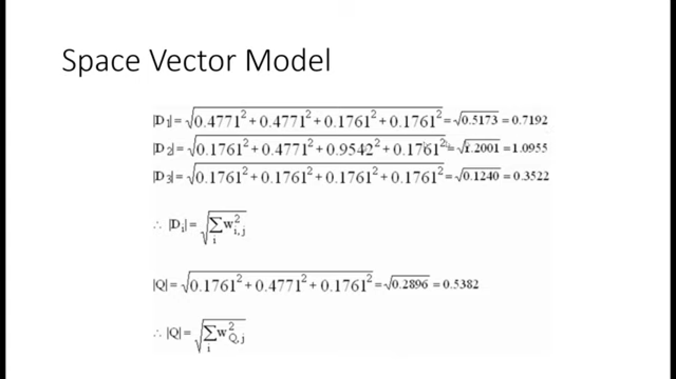
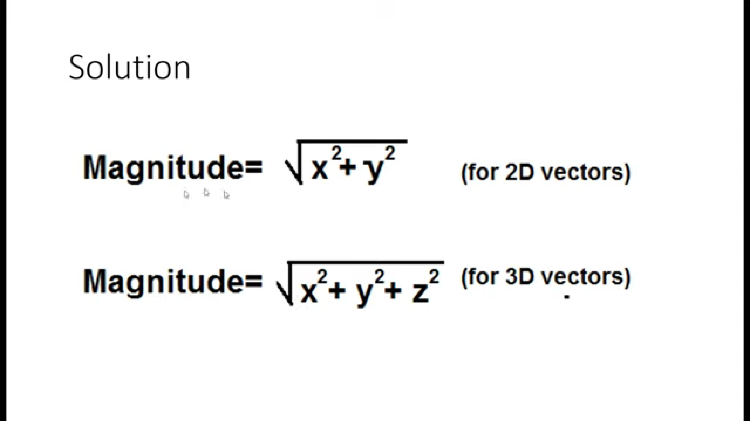
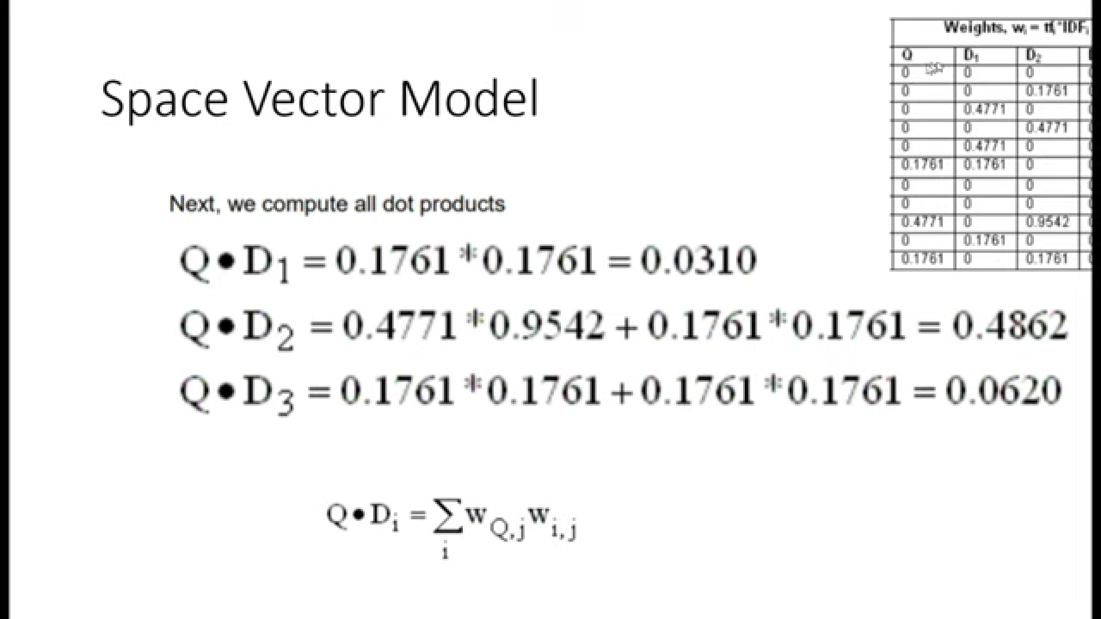

Slide 7
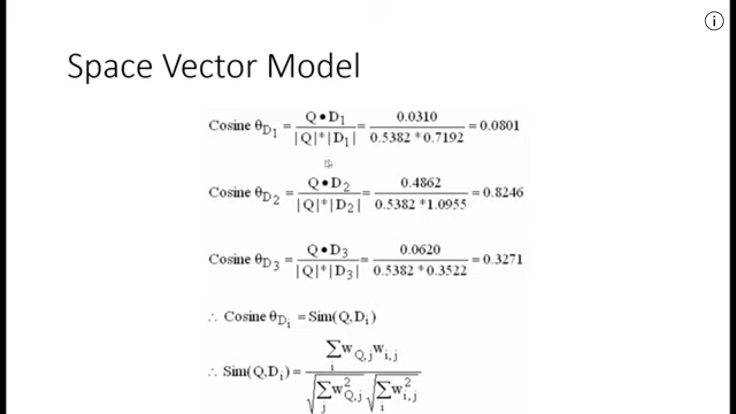

Slide 8
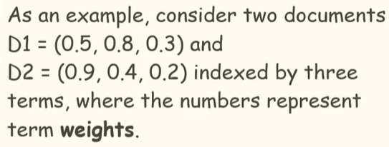
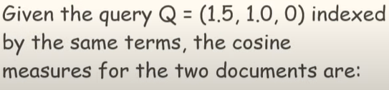
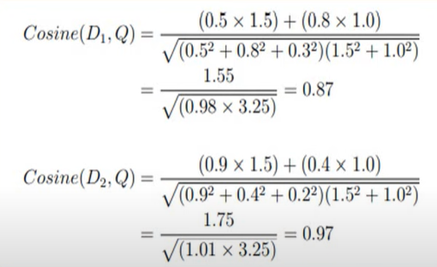
Vector space model: Example

Slide 9
An Example
In similarity matching (cosine):
q=(1, 1, 0)
S(q, A1)=0.71,
S(q, A2)=0.71,
S(q, A3)=0
S(q, A4)=1,
S(q, A5)=0.5
S(q, A6)=0.5
S(q, A7)=0.82,
S(q, A8)=0.5,
S(q, A9)=0.5
Document retrieved set (with ranking)=
{A4, A7, A1, A2, A5, A6, A8, A9}
A document space is defined by three terms: hardware, software, users
A set of documents are defined as:
A1=(1, 0, 0), A2=(0, 1, 0), A3=(0, 0, 1)
A4=(1, 1, 0), A5=(1, 0, 1), A6=(0, 1, 1)
A7=(1, 1, 1) A8=(1, 0, 1). A9=(0, 1, 1)
If the Query is “hardware and software” i.e (1, 1, X) what documents should be retrieved?
In Boolean query matching:
document A4, A7 will be retrieved (“AND”)
retrieved: A1, A2, A4, A5, A6, A7, A8, A9 (“OR”)

Slide 10
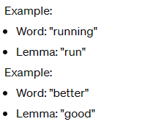

PIPELINE OF NLP IN AI:
Sentence segmentation
It divides the entire paragraph into different sentences for better understanding.
Example: “London is the capital and most populous city of England and the United Kingdom.”
Word tokenization
Word tokenization breaks the sentence into separate words or tokens.
Example: “London”, “is”, “the”, “capital”, “and”, “most”, “populous”, “city”, “of”, “England”, “and”, “the”, “United”, “Kingdom”, “.”
Stemming
Stemming is the process of removing suffixes or prefixes from words to extract their root form, called the stem
Example, “chocolates” becomes “chocolate” and “retrieval” becomes “retrieve”.
Lemmatization:
Lemmatization, on the other hand, aims to reduce words to their canonical or base form,
known as the lemma.
Stop word analysis:
In English, some words appear more frequently than others such as "is", "a", "the", "and". As they appear often, the NLP pipeline flags them as stop words. They are filtered out so as to focus on more important words.

Slide 11
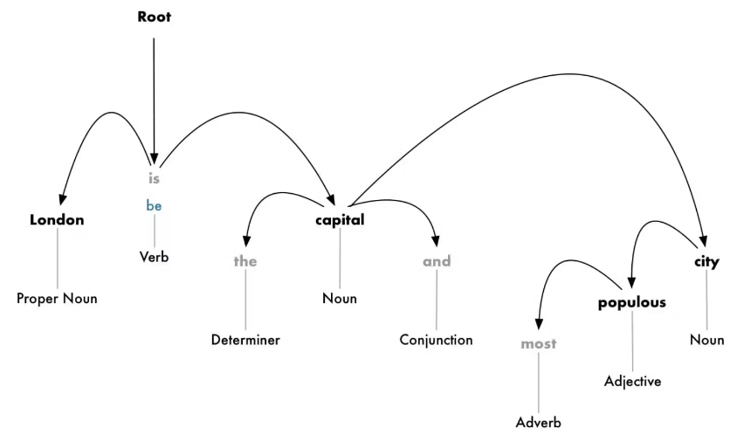
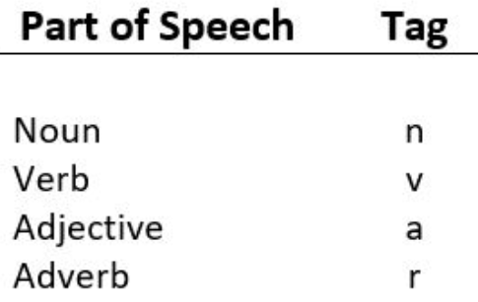
6. Dependency parsing
To find out how all the words in a sentence are related to each other. To find the dependency, we can build a tree and assign a single word as a parent word. The main verb in the sentence will act as the root node.
7. Part-of-speech (POS) tagging
Each word in a document is given a particular part of speech (adverb, adjective, verb, etc.) or grammatical category.

Slide 12
A Running Example
Step 1 – Extract text (i.e. no preposition)
Step 2 – Remove stopword
This is a data mining course.
This is a data mining course
This is a data mining course.
This is a data mining course
We are studying text mining. Text mining is a subfield of data mining.
We are studying text mining Text mining is a subfield of data mining
We are studying text mining. Text mining is a subfield of data mining.
We are studying text mining Text mining is a subfield of data mining
Mining text is interesting, and I am interested in it.
Mining text is interesting and I am interested in it
Mining text is interesting, and I am interested in it.
Mining text is interesting and I am interested in it
P. 12

Slide 13
Step 3 – Convert all words to lower case
Step 4 – Stemming
This is a data mining course.
This is a data mining course.
mine
This is a data mining course
This is a data mining course
text
study
mine
text
mine
We are studying text mining. Text mining is a subfield of data mining.
We are studying text mining Text mining is a subfield of data mining
We are studying text mining. Text mining is a subfield of data mining.
We are studying text mining Text mining is a subfield of data mining
mining
mine
interest
Mining text is interesting, and I am interested in it.
Mining text is interesting and I am interested in it
Mining text is interesting, and I am interested in it.
Mining text is interesting and I am interested in it
interest
P. 13

Slide 14
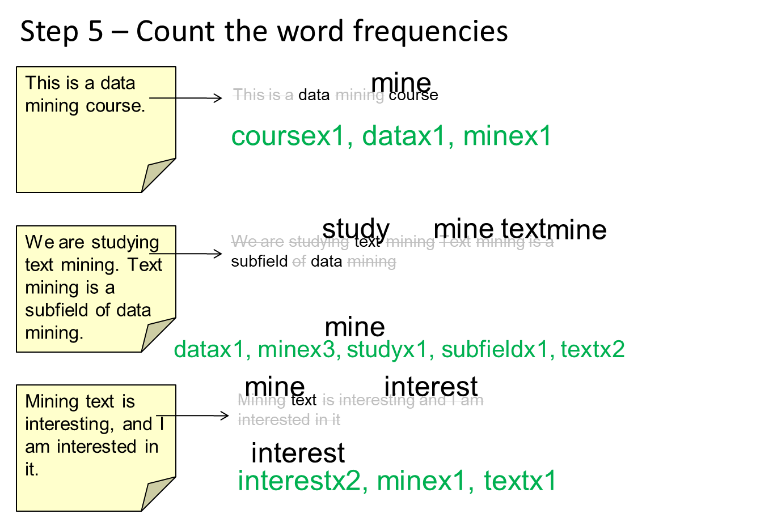
ID | word | doc freq
1 | course | 1
2 | data | 2
3 | interest | 1
4 | mine | 3
5 | study | 1
6 | subfield | 1
7 | text | 2

Slide 15
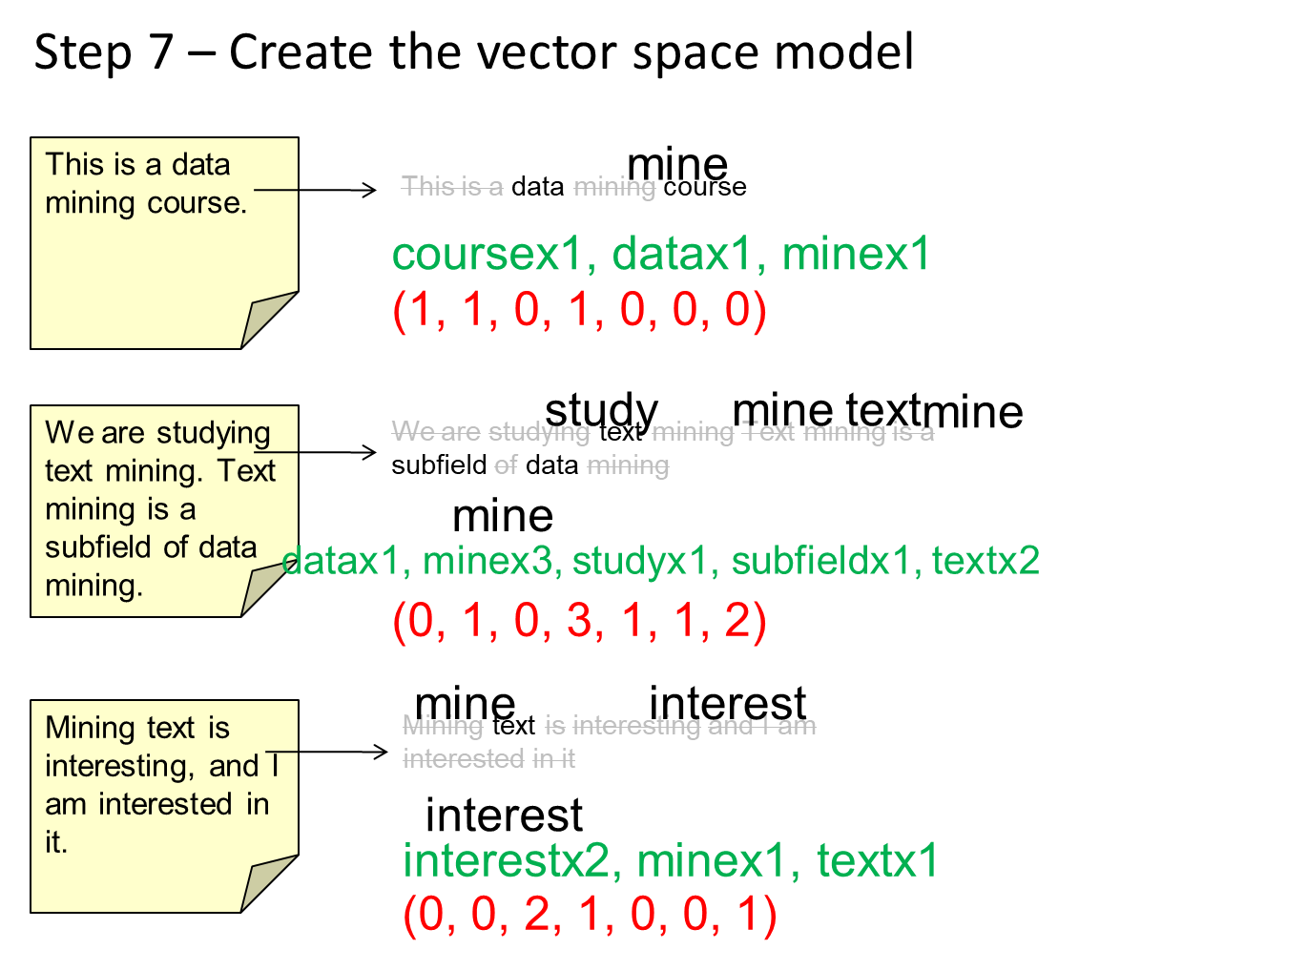

Slide 16
Step 8 – Compute the inverse document frequency
This is a data mining course.
(1, 1, 0, 1, 0, 0, 0)
ID | word | document frequency | IDF
1 | course | 1 | 0.477
2 | data | 2 | 0.176
3 | interest | 1 | 0.477
4 | mine | 3 | 0
5 | study | 1 | 0.477
6 | subfield | 1 | 0.477
7 | text | 2 | 0.176
We are studying text mining. Text mining is a subfield of data mining.
(0, 1, 0, 3, 1, 1, 2)
Mining text is interesting, and I am interested in it.
(0, 0, 2, 1, 0, 0, 1)

Slide 17
Step 9 – Compute the weights of the words
This is a data mining course.
(1, 1, 0, 1, 0, 0, 0)
ID | word | document frequency | IDF
1 | course | 1 | 0.477
2 | data | 2 | 0.176
3 | interest | 1 | 0.477
4 | mine | 3 | 0
5 | study | 1 | 0.477
6 | subfield | 1 | 0.477
7 | text | 2 | 0.176
(0.477, 0.176, 0, 0, 0, 0, 0)
We are studying text mining. Text mining is a subfield of data mining.
(0, 1, 0, 3, 1, 1, 2)
(0, 0.176, 0, 0, 0.477, 0.477, 0.352)
Mining text is interesting, and I am interested in it.
(0, 0, 2, 1, 0, 0, 1)
(0, 0, 0.954, 0, 0, 0, 0.176)
P. 17

Slide 18
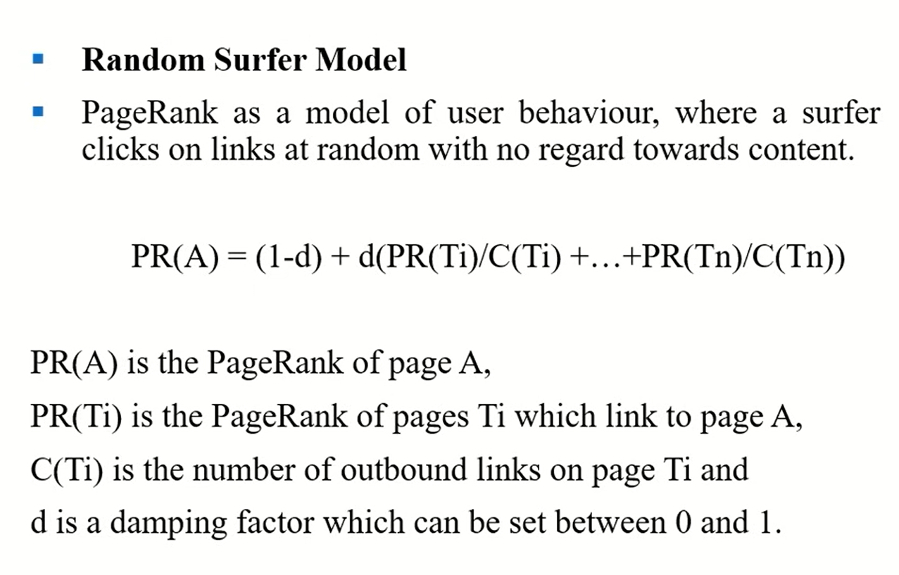
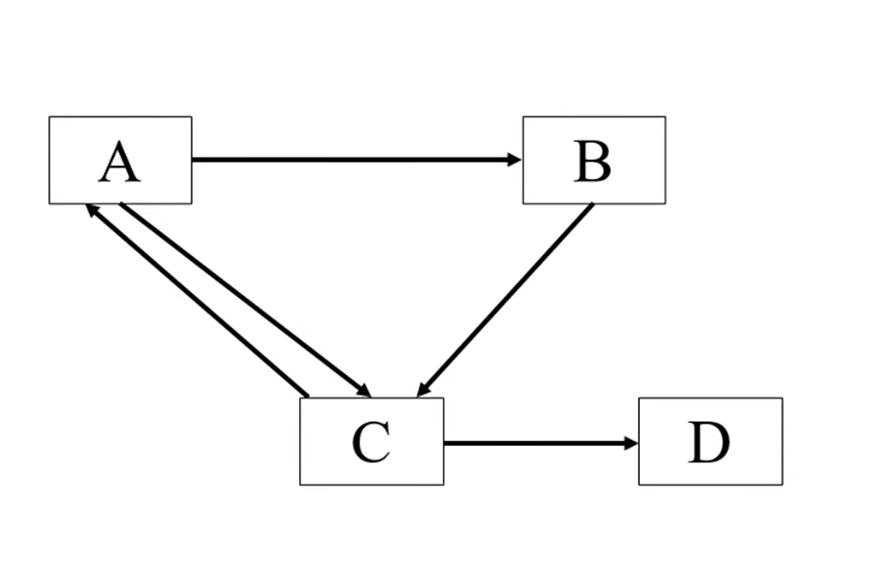
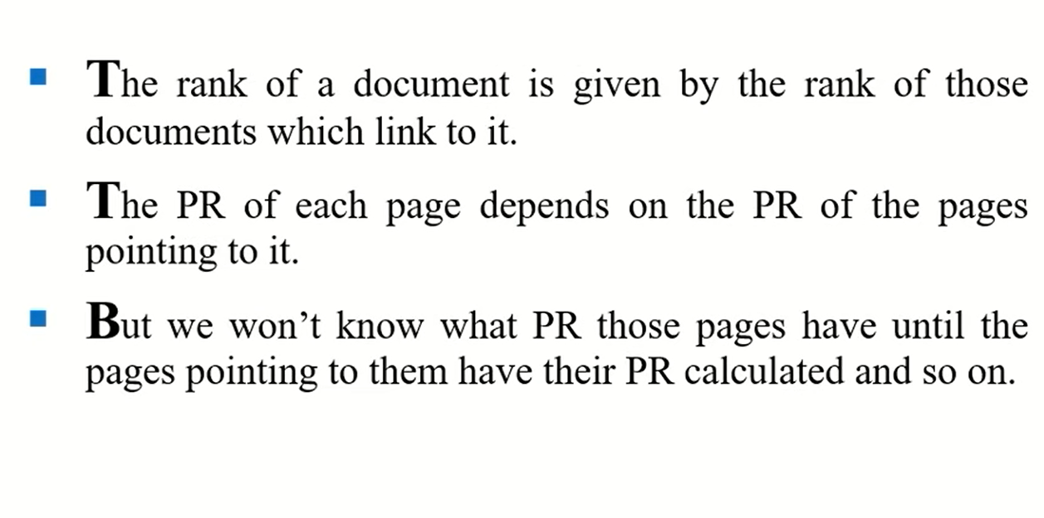
https://youtu.be/xJUwspSaR1E?si=yatKMxcbyee3qOSm
D has no outbound links. As PR is computed by no. of inbound links divided by outbound links and outbound links is 0, it is called dangling link/dead link

Slide 19
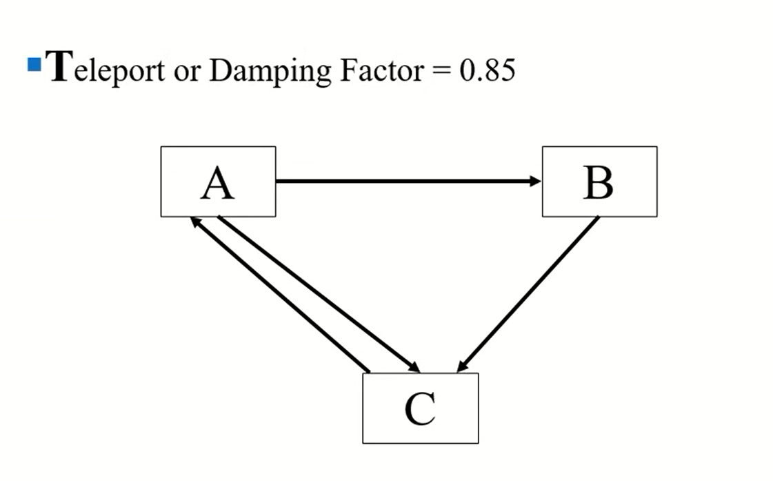
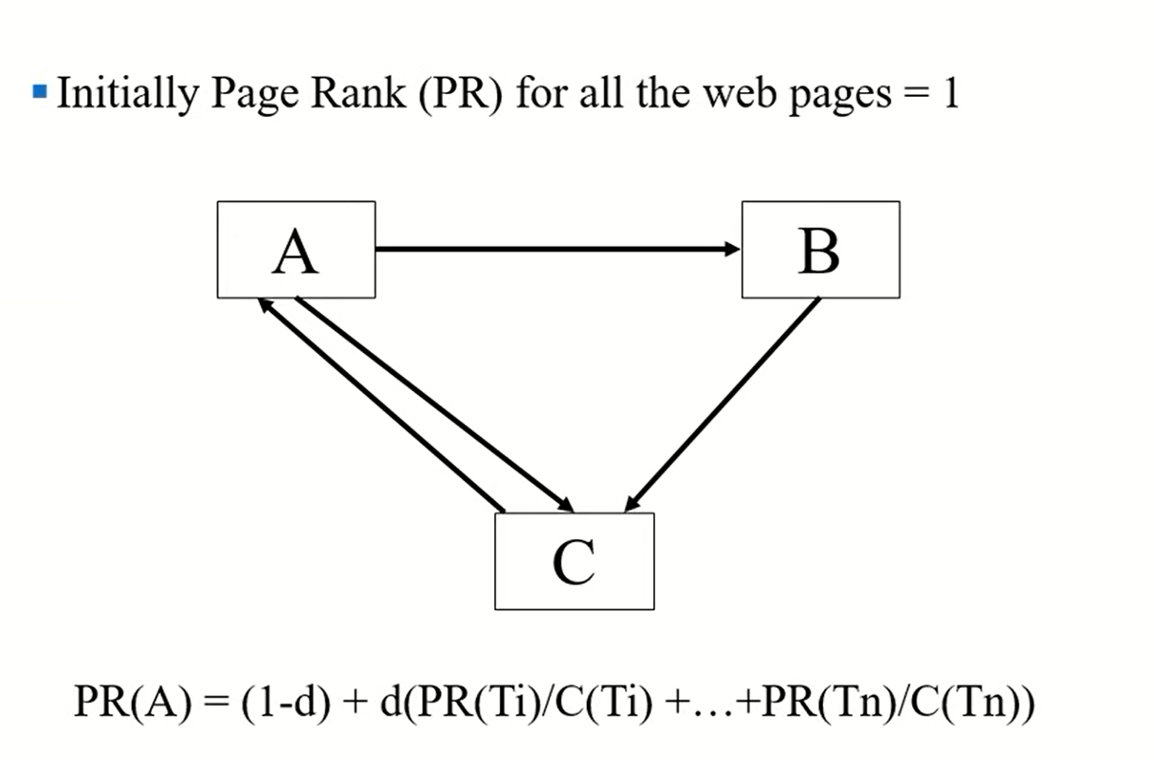
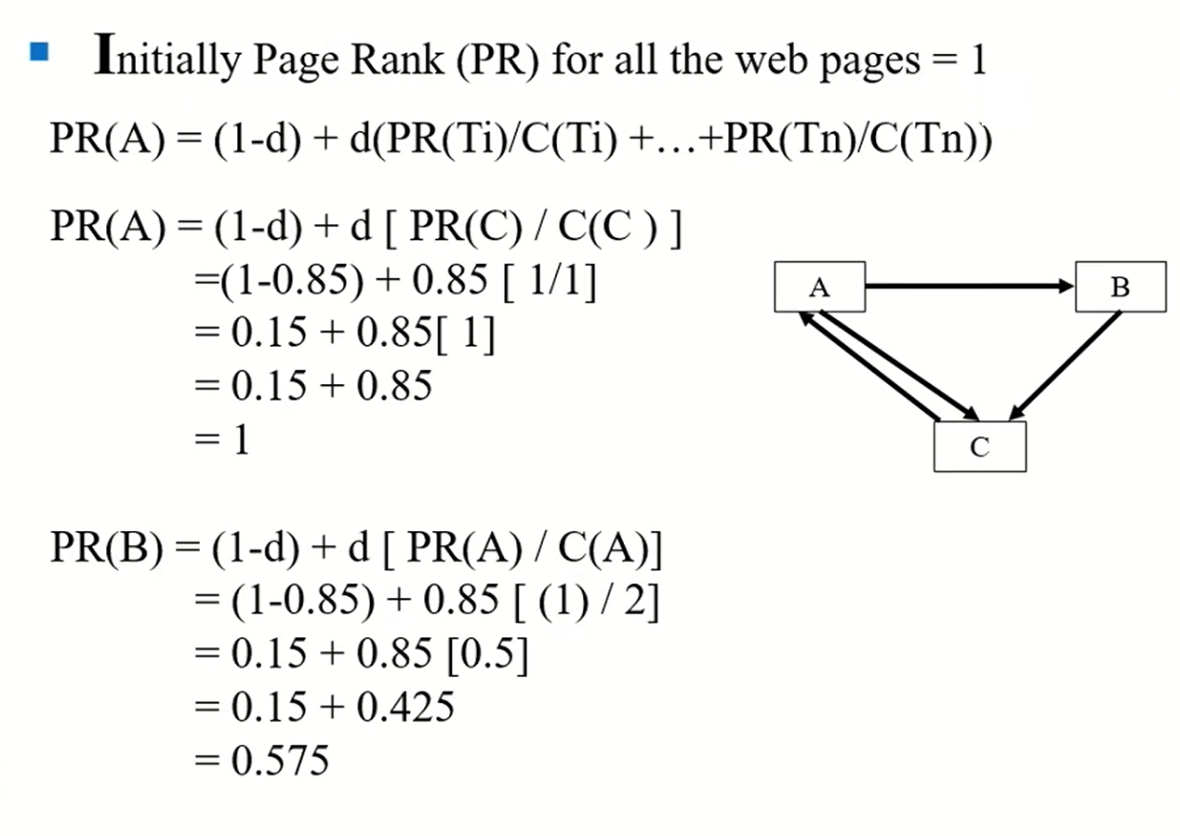
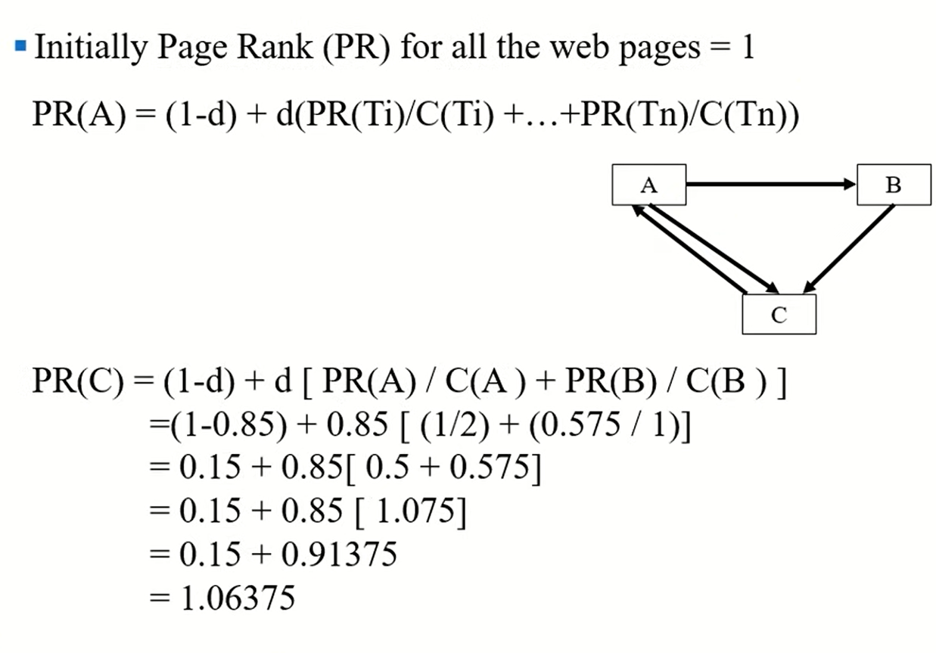
Question:
For PR(A) we are calculating PR(C)/C(C) because the inbound node to A is C. Similarly, For PR(B) we are calculating PR(A)/C(A) because the inbound node to B is A.
PR(C) = no. of inbound links to C = 2 but initial PR for all webpages is 1 by defaults so consider 1
C(C) = no. of outbound links from C = 1
PR(A) = no. of inbound links to A = 1
C(A) = no. of outbound links from A = 2
PR(A) is used in calculation for PR(B)
End of iteration 1

Slide 20
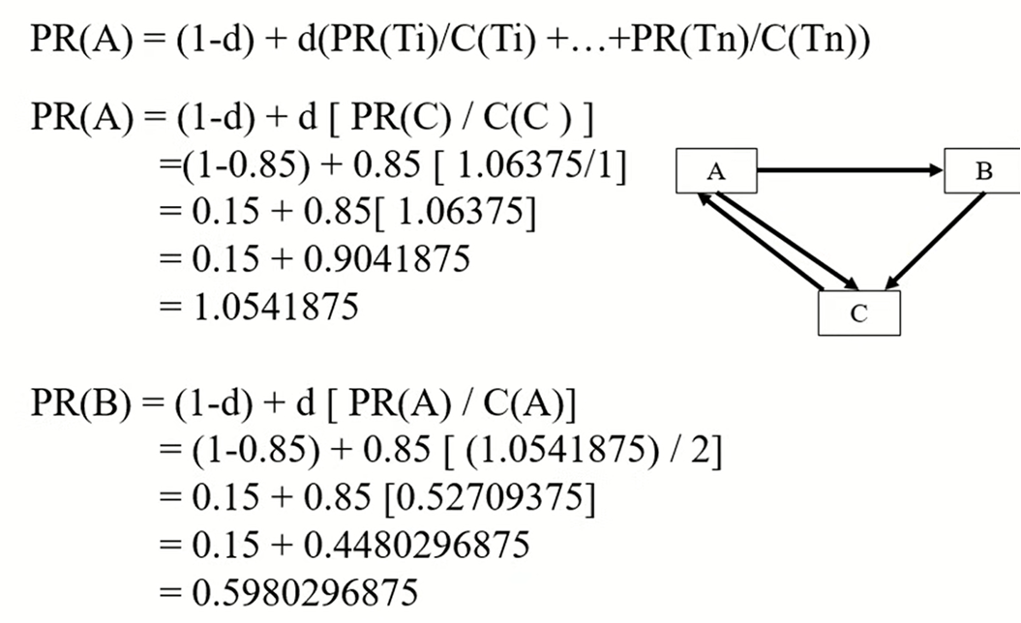
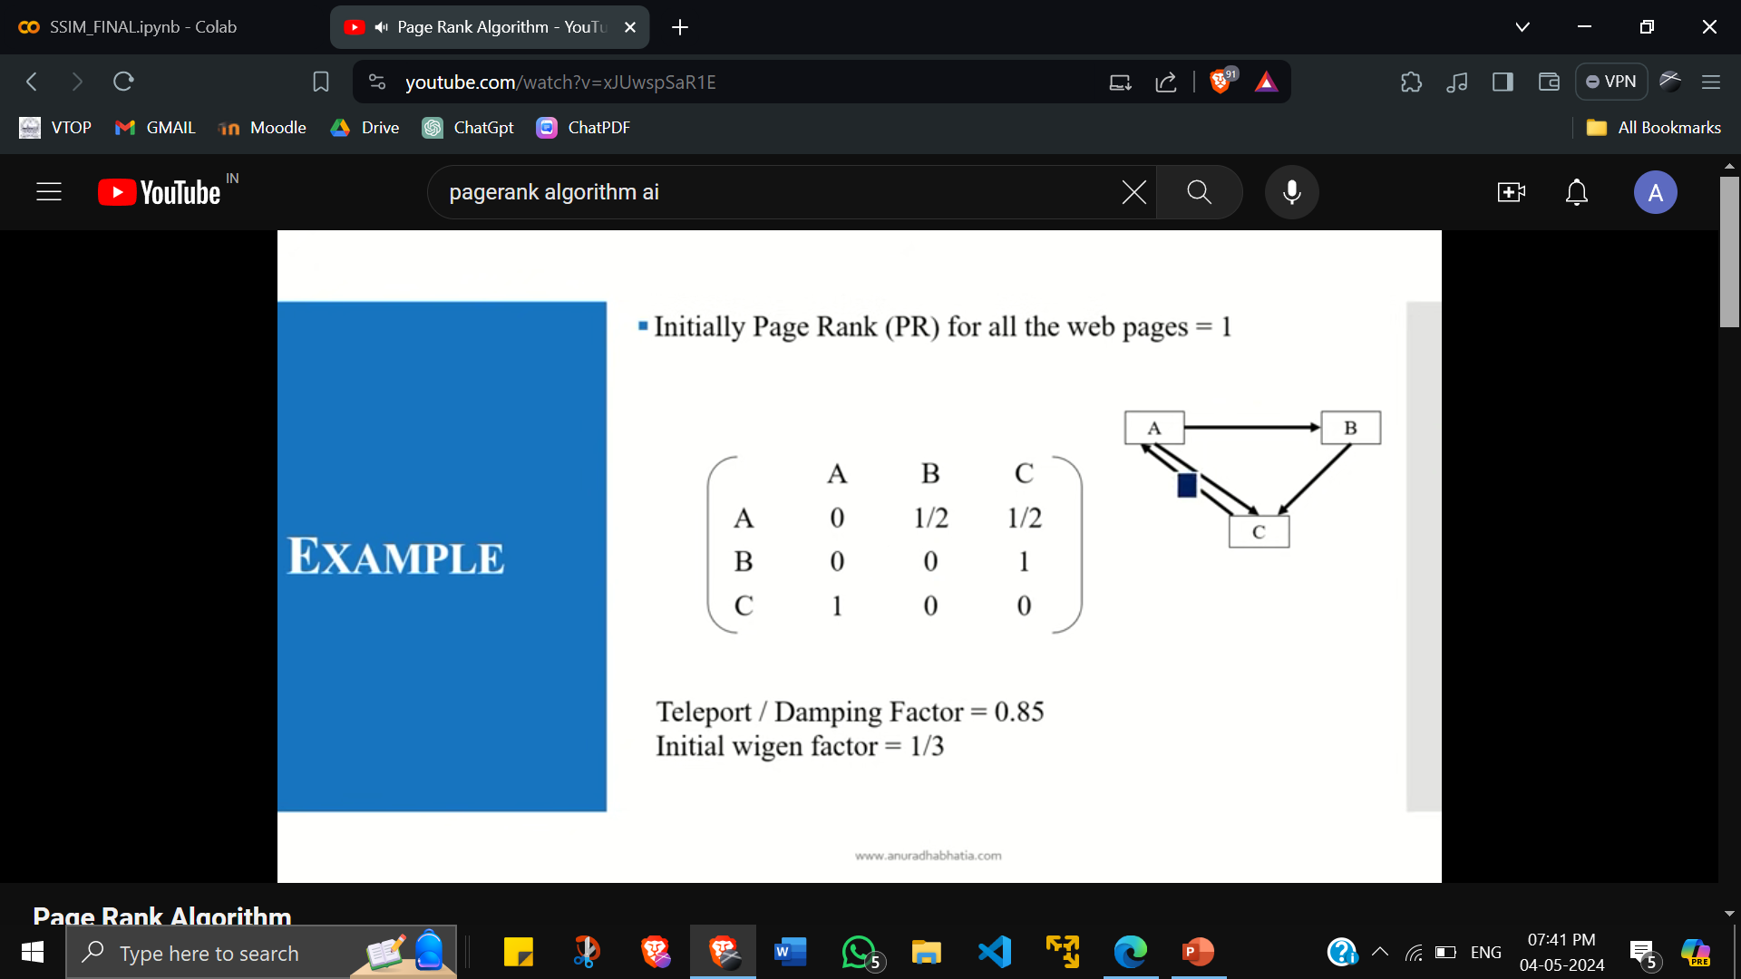
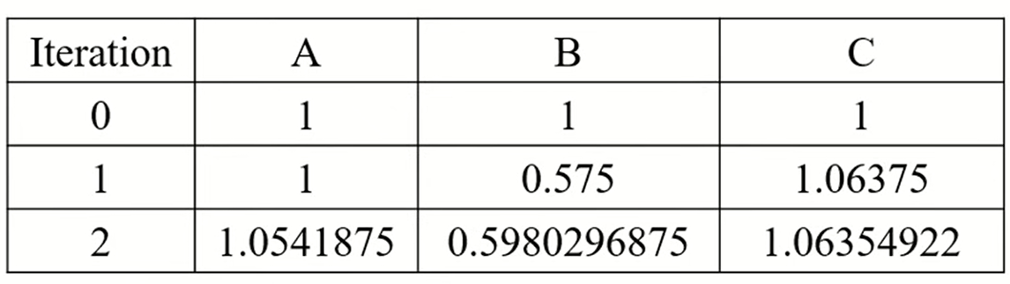
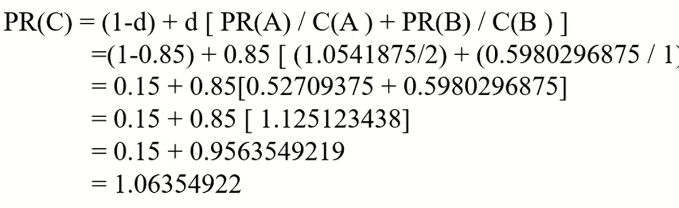
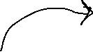
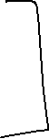

Use PR values from previous iteration:
This diagram can be represent in the form on matrix. Here ½ means there is 1 inbound rule to A divided by 2 outbound rules of A. 1 means 1 inbound rule to B divided by 2 outbound rules of B.
End of iteration 2

Slide 21
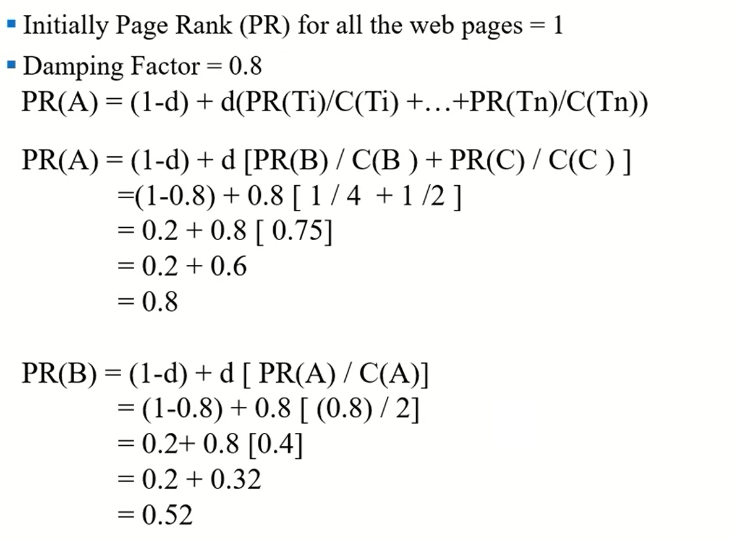
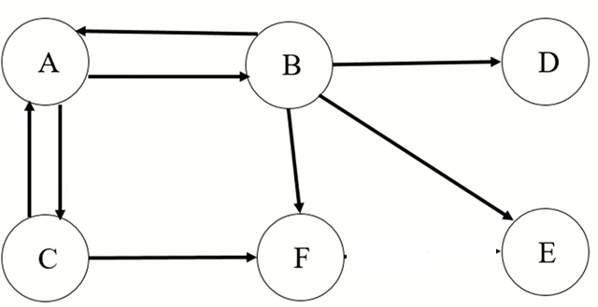
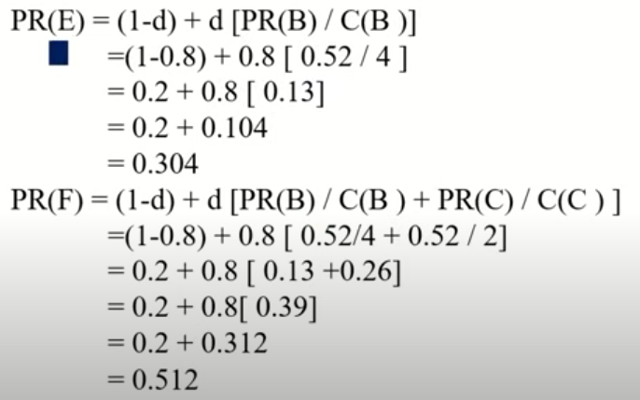
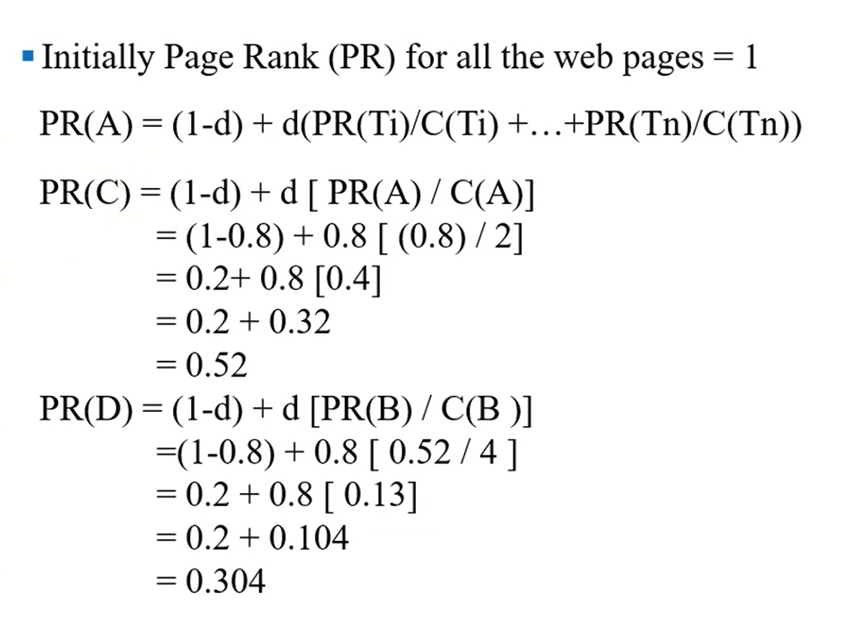
End of iteration 1

Slide 22
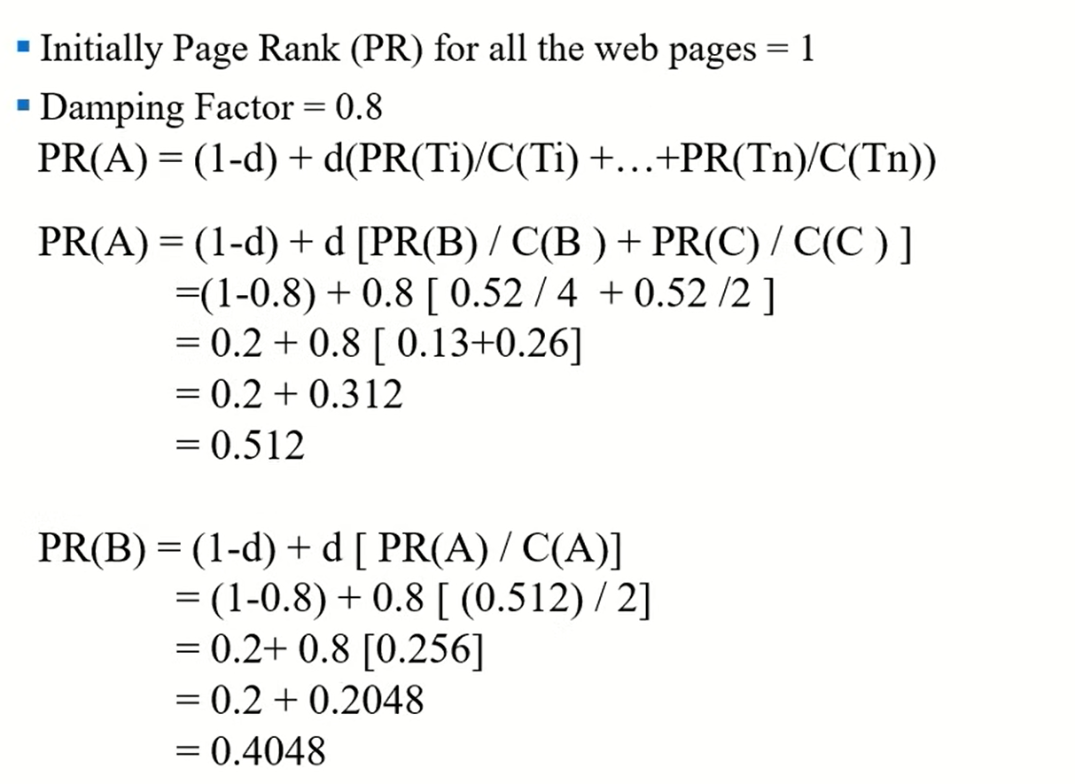
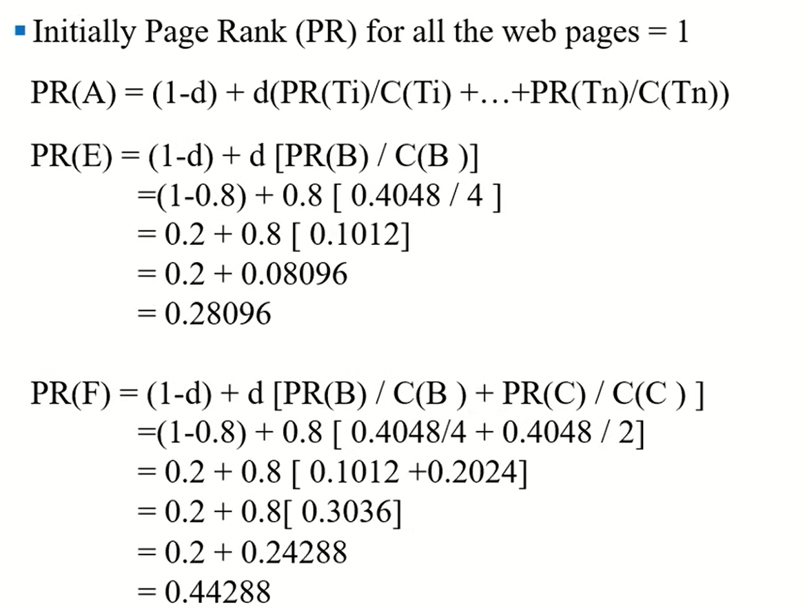
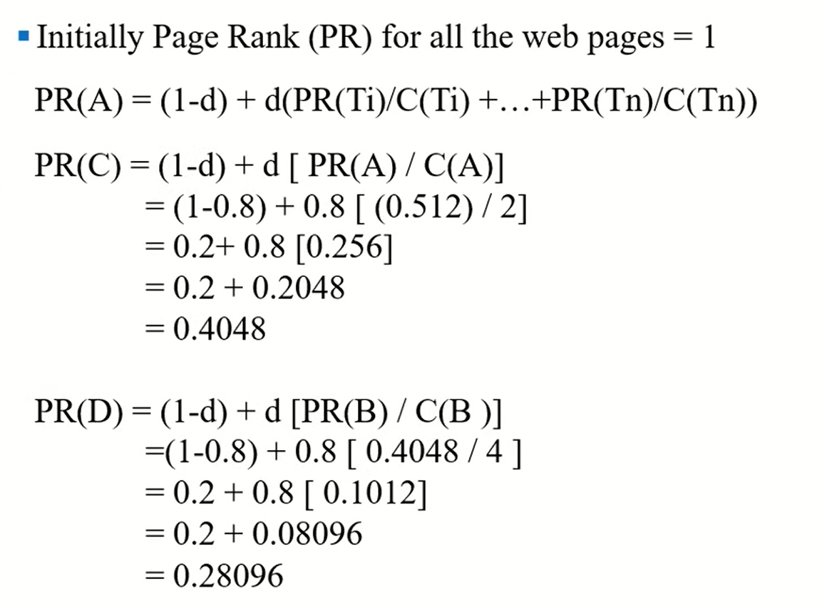
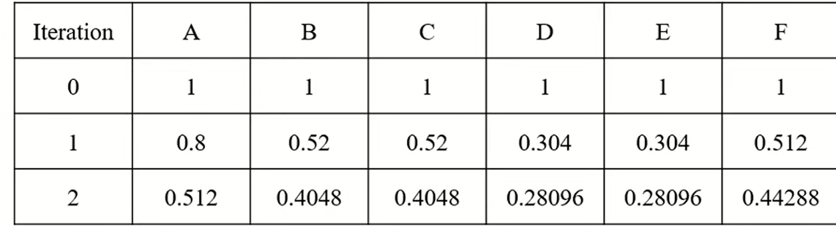
Use PR values from previous iteration:
End of iteration 2

Slide 23
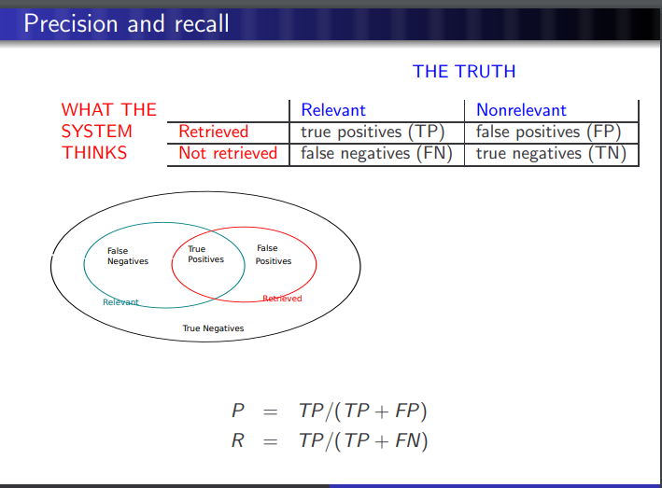
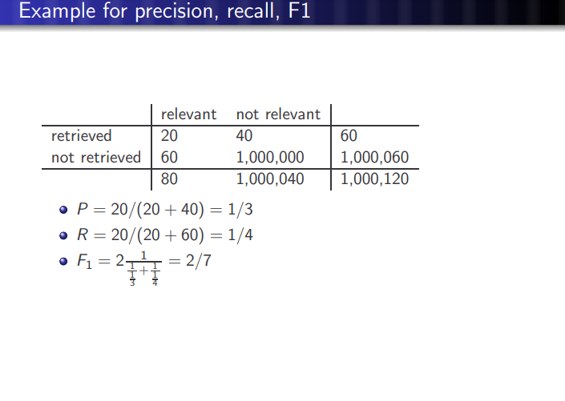
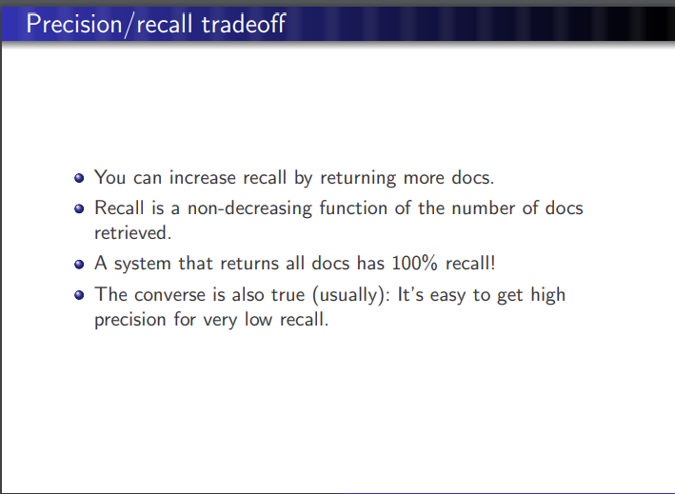
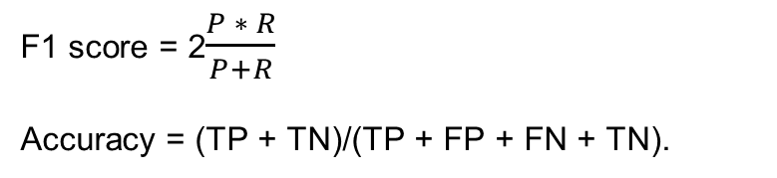
Evaluating IR
F1 score = 2$\frac{P ∗ R}{P+R}$
Accuracy = (TP + TN)/(TP + FP + FN + TN).

